Slide 1
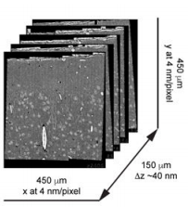
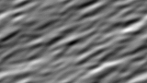
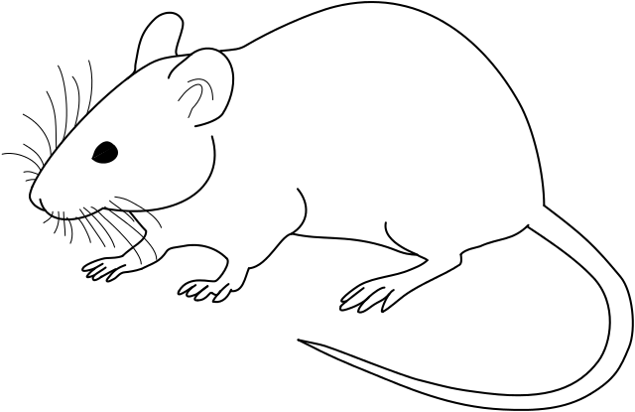
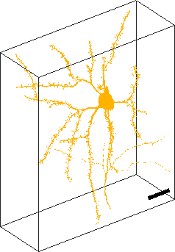

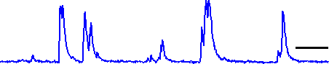
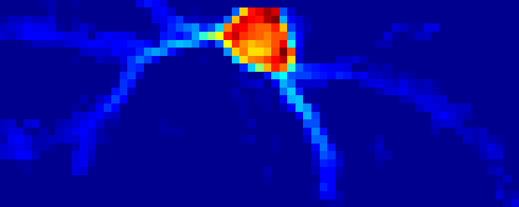
Visual stimulation
Calcium imaging
Electron microscopy
serial section TEM
GCaMP6
Segmentation
Time
20um
5 sec.
function
structure
Notes:
mouse: https://scubasanmateo.com/images/mouse-clipart-black-and-white-3.png

Slide 2
Visual stimulation
Calcium imaging
Electron microscopy
serial section
TEM
GCaMP6
z
Segmentation
Time
20um
5 sec.
function
structure
Notes:
mouse: https://scubasanmateo.com/images/mouse-clipart-black-and-white-3.png

Slide 3
Time

